Slide 1

Chapter 9: Dynamic Interaction Modeling

Slide 2
Introduction
Chapter 8: determine the objects that participate in each use case => dynamic behavior
Dynamic modeling provides a view of a system in which control and sequencing are considered, either within an object (by means of a finite state machine) or between objects (by analysis of object interactions). This chapter addresses dynamic interaction between objects
Dynamic interaction modeling is based on the realization of the use cases developed during use case modeling. For each use case, it is necessary to determine how the objects that participate in the use case dynamically interact with each other.
This chapter describes stateless dynamic interaction modeling

Slide 3
Contents
1. Object interaction modeling
2. Dynamic interaction modeling
3. Example

Slide 4
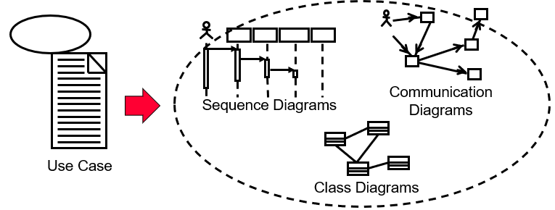
1. Object interaction modeling
For each use case, the objects that realize the use case dynamically cooperate with each other and are depicted on either a UML communication diagram or a UML sequence diagram.

Slide 5
1.1. Communication Diagrams
A communication diagram is a UML interaction diagram that depicts a dynamic view of a group of objects interacting with each other by showing the sequence of messages passed among them.
During analysis modeling, a communication diagram is developed for each use case;
The message sequencing on the communication diagram should correspond to the sequence of interactions between the actor and the system already described in the use case

Slide 6
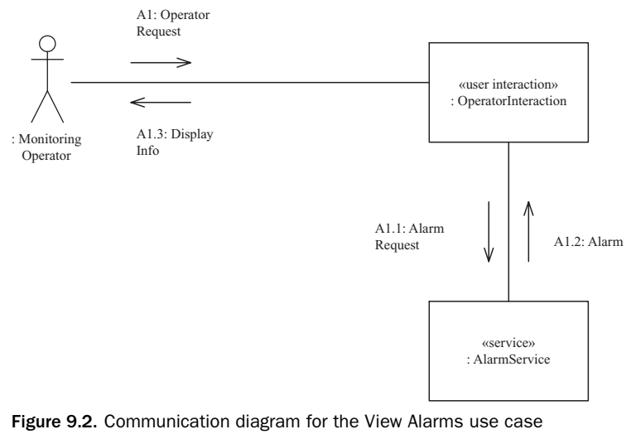
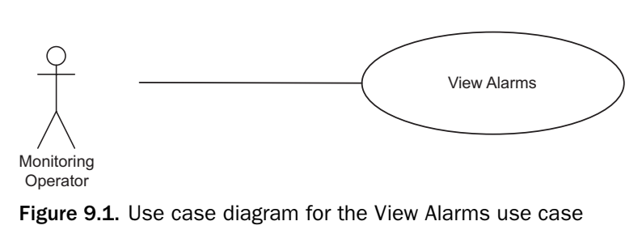
1.1. Communication Diagrams
Example: View Alarm UC
The communication diagram for the View Alarms UC depicts the user interaction object, Operator Interaction, making a request to the service object, Alarm Service & receiving a response

Slide 7
1.2. Sequence Diagrams
The interaction among objects can also be shown on a sequence diagram, which shows object interactions arranged in time sequence.
A sequence diagram shows the objects participating in the interaction and the sequence in which messages are sent. Sequence diagrams can also depict loops and iterations
Numbering the messages is not essential because shows message sent are shown in order

Slide 8
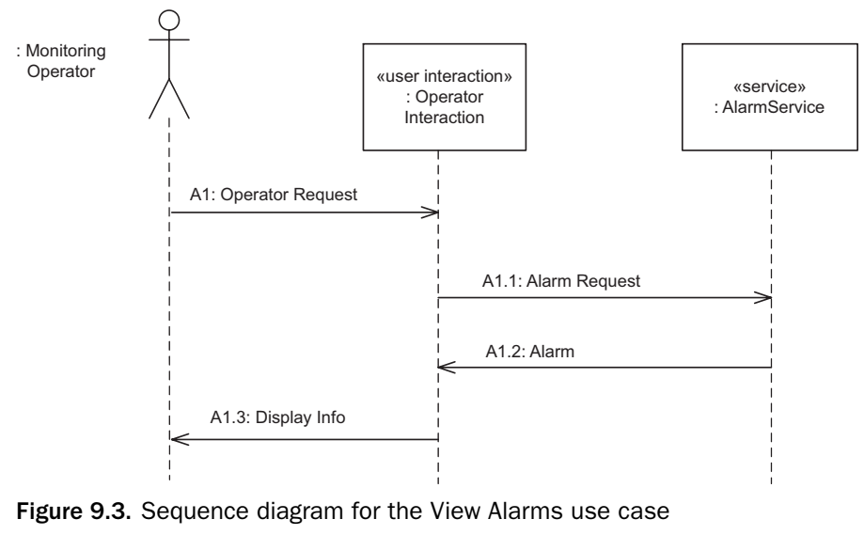
1.2. Sequence Diagrams
Example: sequence diagram for the View Alarms use case
Sequence diagram conveys the same information as the communication diagram

Slide 9
1.3. Sequence Diagram versus Communication Diagram
Communication diagrams and sequence diagrams are both interaction diagrams in UML
The sequence diagram clearly shows the order (time order) in which messages are passed between objects.
Seeing how the objects are connected to each other is more difficult
The communication diagram shows the layout of the objects, particularly how the objects are connected to each other .
Question: Which is better? When we develop an application, which one would we use?

Slide 10
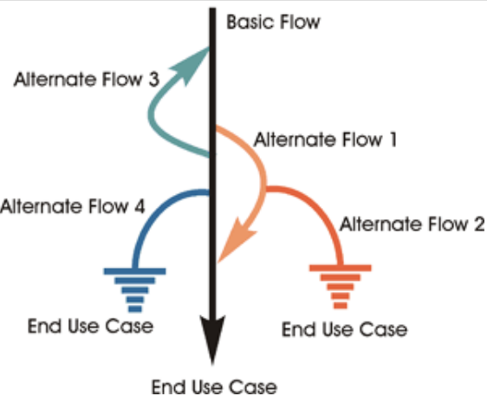
1.5. Use Cases and Scenario
A scenario is one specific path through a use case. Thus, a particular message sequence depicted on an interaction diagram actually depicts a scenario and not a use case.
To show all the alternatives through a use case, development of more than one interaction diagram is often necessary.

Slide 11
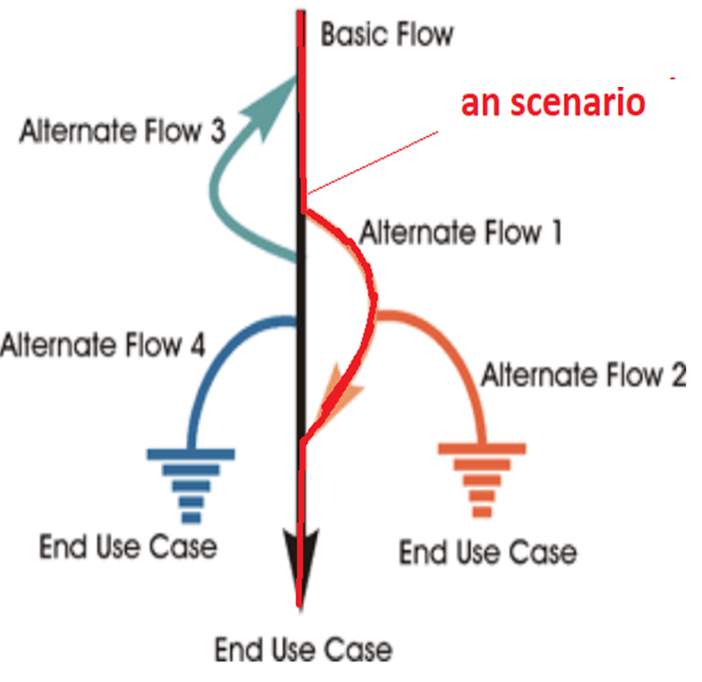
1.5. Use Cases and Scenario
A scenario is one specific path through a use case. Thus, a particular message sequence depicted on an interaction diagram actually depicts a scenario and not a use case.
To show all the alternatives through a use case, development of more than one interaction diagram is often necessary.

Slide 12
1.6.Generic and Instance Forms of Interaction Diagrams
The two forms of an interaction (sequence or communication) diagram:
The instance form describes a specific scenario in detail, depicting one possible sequence of interactions among object instances
Using the instance form might require several interaction diagrams to depict a given use case, depending on how many alternatives are described in the use case
The generic form describes all possible interactions in which the objects might participate, and so can include loops, branches, and conditions.

Slide 13
2. Dynamic interaction modeling
Dynamic interaction modeling is an iterative strategy to help determine how the analysis model objects interact with each other to support the use cases.
Dynamic interaction modeling is carried out for each use case.
Dynamic interaction modeling can be either state-dependent or stateless. This chapter describes stateless dynamic interaction modeling

Slide 14
3. Stateless Dynamic interaction modeling
The main steps in the stateless dynamic interaction modeling approach are as follows, starting with the use case. Next consider the objects needed to realize the use case, then determine the sequence of message communication among the objects:
1. Develop use case model
2. Determine objects needed to realize use case
2a. Determine boundary object(s)
2b. Determine internal software objects
3. Determine message communication sequence.
4. Determine alternative sequences

Slide 15
2a. Determine boundary object(s)
Consider the actor (or actors) that participates in the use case; determine the external objects (external to the system) through which the actor communicates with the system, and the software objects that receive the actor’s input
Start by considering the inputs from the external objects to the system. For each external input event, consider the software objects required to process the event. A software boundary object (such as an input object or user interaction object) is needed to receive the input from the external object. On receipt of the external input, the boundary object does some processing and typically sends a message to an internal object

Slide 16
2b. Determine internal software objects
Consider the main sequence of the use case. Using the object structuring criteria, make a first attempt at determining the internal software objects that participate in the use case, such as control or entity objects.

Slide 17
3. Determine message communication sequence
For each input event from the external object, consider the communication required between the boundary object that receives the input event and the subsequent objects – entity or control objects – that cooperate in processing this event
This sequence typically starts with an external input from the actor (external object), followed by a sequence of internal message between the participating software objects, through to an external output to the actor (external object)

Slide 18
4. Determine alternative sequences
Consider the different alternatives, such as error handling, which are described in the Alternatives section of the use case. Then consider what objects need to participate in executing the alternative branches and the sequence of message communication among them

Slide 19
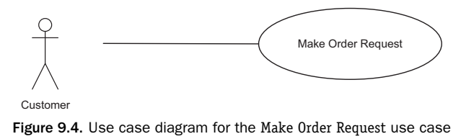
4. Examples of Stateless Dynamic Interaction Modeling
Make Order Request use case

Slide 20
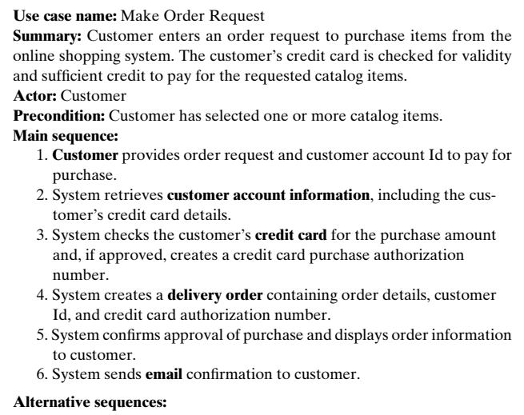
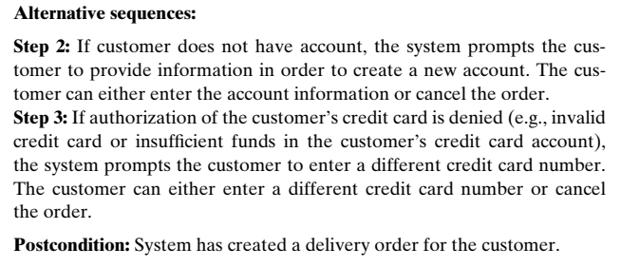
4. Examples of Stateless Dynamic Interaction Modeling
1. Develop Use Case Model

Slide 21
4. Examples of Stateless Dynamic Interaction Modeling
2. Determine Objects Needed to Realize Use Case
Customer actor => user interaction object: Customer Interaction.
Customer account infor, Credit card, Delivery order, Email => Service objects: Customer Account Service, Credit Card Service, Delivery Order Service, and Email Service.
Coordinator object, Customer Coordinator, to coordinate the interactions between Customer Interaction and the four service objects.

Slide 22
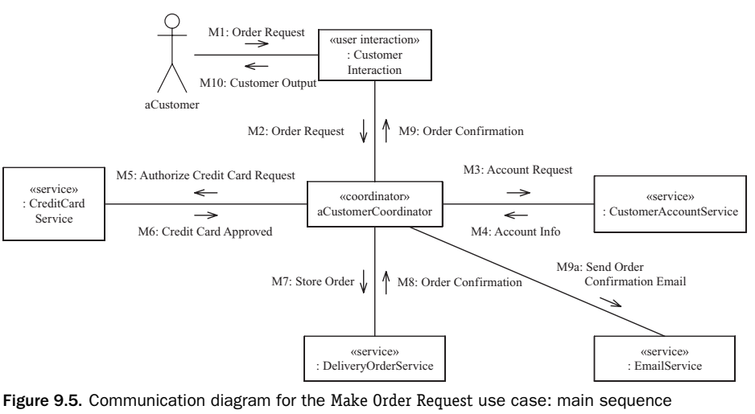
4. Examples of Stateless Dynamic Interaction Modeling
3. Determine Message Communication Sequence

Slide 23
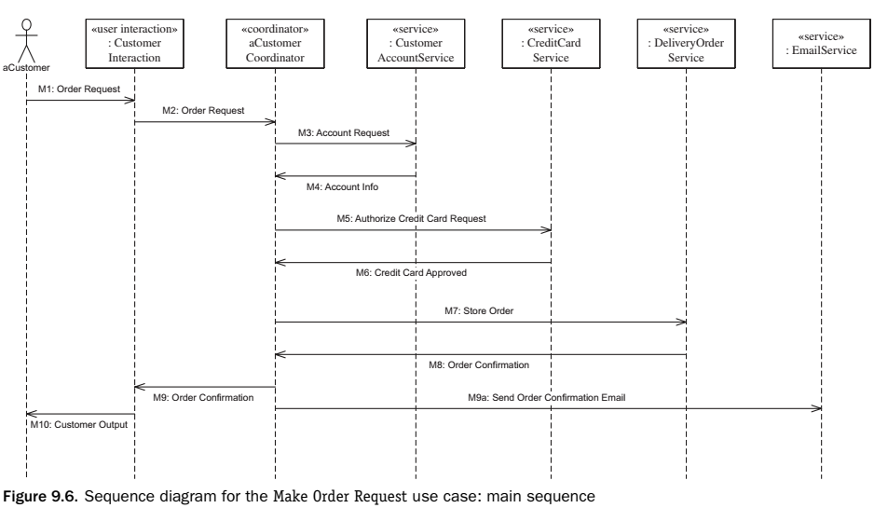
4. Examples of Stateless Dynamic Interaction Modeling
3. Determine Message Communication Sequence

Slide 24
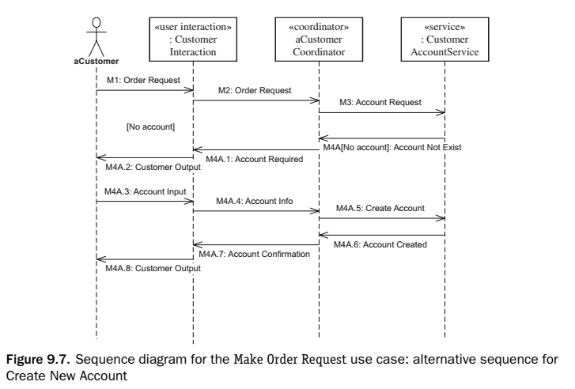
4. Examples of Stateless Dynamic Interaction Modeling
4. Determine Alternative Sequences: no account, credit card authorization is denied

Slide 25
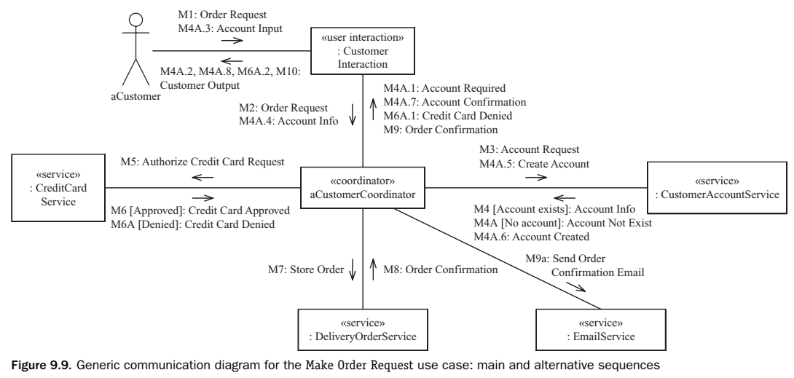
4. Examples of Stateless Dynamic Interaction Modeling
Generic communication diagram

